Slide 1
CS 0447 Recitation 4

Slide 2
Last Week’s Quiz
Q1
A: Moving/Splitting data larger than single bytes, between the CPU and memory, and between multiple computers
Endianness effects the ordering of bytes in data larger than one byte. The CPU must account for endianness when loading/storing. If two computers disagree on endianness, there may be problems moving data between them
Q2
A: 23
This code initializes an array of 10 words with each entry being set to 23
Notes:
Q1 - What does endianness affect?
Q2 - Given an array arr defined as: "arr: .word 23:10"
What is the value of arr [2] ?

Slide 3
Last Week’s Quiz
Q3
A: 116
Remember the formula: Address = A + (i * n)
Q4.1
A: 0xCDAB8967
The machine is little endian, so the end of the word (67) is in the little address
Q4.2
A: 0x6789ABCD
The machine is big endian, so the end of the word (CD) is in the big address
Notes:
Q3 - You have an array of 32-bit words that starts at address 100. What is the address of the value at index 4?
Q4 - The following bytes and associated addresses are stored in memory:
67 - 0 89 - 1 AB - 2 CD - 3
Q4.1 - What word do these four bytes represent on a little-endian machine?
Q4.2 - What word do these four bytes represent on a big-endian machine?

Slide 4
Last Week’s Quiz
Q5
A: 00010101
Sign extension will spread out the leftmost bit to fill the register
Notes:
Q5 - I want to use sign extension on the number 010101 such that it is 1 byte in size; which of the following is the result?

Slide 5
This Week’s Quiz
You have the next 5 minutes to work on this week’s quiz on Gradescope

Slide 6
Control Flow
We want our programs to be able to make decisions
Otherwise a CPU is just an expensive calculator
In a high level language, we have things like if-statements, loops, functions, and so on
In assembly, all we are guaranteed is that our code will run in order

Slide 7
Control flow
In MIPS, all control flow is done using branches and jumps
These instructions move us to somewhere else in the code
Example:
_loop:
# do some things…. j _loop

Slide 8
Conditional Branching in MIPS
Conditional branch instructions in MIPS work like this:
If the condition is met, go to the label
Otherwise, move to the next line of code as normal
Instruction | HLL Translation
beq t0, t1, label | if (t0 == t1) { goto label }
bne t0, t1, label | if (t0 != t1) { goto label }

Slide 9
Illustration
Previous Instruction
beq = branch if equal
beq t0, t1, label
t0 == t1
True
False
Next instruction
Label

Slide 10
Conditionals in MIPS vs Java
In Java you might write something like:
if (x == y) { do_stuff(); }
You go into the block if the condition is true and skip over it otherwise
In MIPS this convention is inverted!
You might write something like: bne t0, t1, _blockB _blockA: # do stuff _blockB: # do different stuff

Slide 11
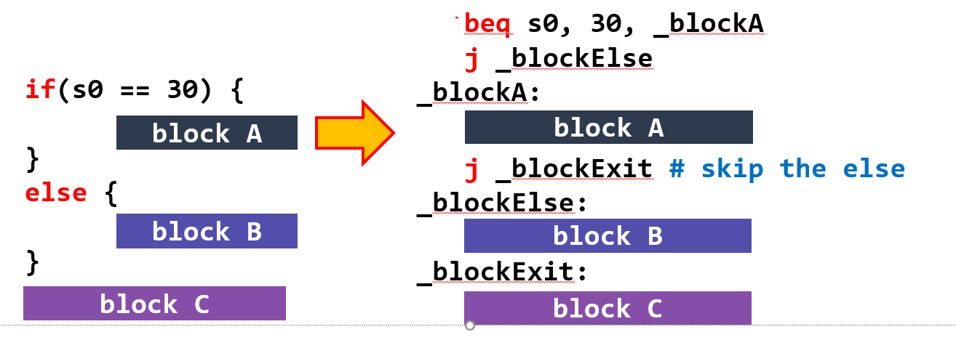
An Alternative approach
We can use something like this to avoid having to think about if-statements in a backwards way
Here, we jump to block A when the condition is true and to _blockElse when it is false
This maps more closely onto HLL if-statements

Slide 12
MIPS Branching Instructions
In addition to beq and bne, MIPS also has
blt: branch less than
ble: branch less or equal
bgt: branch greater than
bge: branch greater or equal
So we can do all the comparisons that we could do in a HLL

Slide 13
Short Circuit Evaluation
In a HLL like Java, when we have an or condition, we stop evaluating once we find one true clause!
Example: if (a || b || c || d)
If a is true, there is no reason to evaluate b, c, or d – the result of the expression will always be true!
Also, if we are doing a logical and, once we find a false clause we can stop evaluating
Example: if (a && b)
If a is false, we don’t need to evaluate b
We can accomplish this in MIPS by using multiple branch instructions

Slide 14
Loops in Java
What is this loop really doing?
for (int i = 0; i < 10; i++) { do_stuff(); }
Initialize i
Check the condition i < 10
If the condition is met, do stuff
Go back to the top!

Slide 15
Loops in MIPS
We know how to do all the things from the previous slide in MIPS
We can initialize a counter with li/lw
We can check a condition with a branch instruction
The branch instruction will also allow us to leave the loop when the condition is not met
We can return the top of the loop with a jump instruction
Remember: all MIPS gives us is that the instructions will execute in order. We use branches/jumps to build control structures

Slide 16
Calling Conventions
Calling conventions define how functions call one another at the assembly level
They are not enforced by the CPU – they’re a set of rules that we follow as programmers
They define things like how arguments are passed to functions, how return values are sent back, how we enter a function, etc

Slide 17
The Program Counter
The instructions for a program are stored in memory
Therefore, instructions have addresses
The program counter (PC) register holds the address of the next instruction to execute
When we use those branch instructions, we are changing the address stored in PC

Slide 18
Calling Functions in MIPS
We use the jal instruction to call functions in MIPS
It stands for Jump and Link
jal sets PC to the address of a label and stores the old PC in the ra register
This is all jal does! It modifies the value held in two registers.
Modifying the PC register’s value is what moves us to the label’s location in our code

Slide 19
Returning From Functions in MIPS
We return from a function using the jr ra instruction
jr stands for jump to register
We use the ra argument to the instruction to jump to the address stored in the ra register
Remember where jal stores the old value of PC – we’re jumping back to where the function was called from
All jr ra does is set PC to the value stored in ra

Slide 20
Arguments and Return Values
We pass arguments to functions using the a registers
a0 – a3
Functions put their return values in the v registers
v0 – v1
This is just a convention! There is nothing stopping you from using other registers, but don’t

Slide 21
Putting it Together
We know enough now to properly call a function
Let’s say we have a function that adds two numbers and returns the sum – something like int add_nums(int num1, int num2)
We put the arguments in a0 and a1
We call the function using jal
We get the return value in v0

Slide 22
Saved and Unsaved Registers
A caller cannot depend on the values in t, a, or v registers being preserved after a function call!
Functions are free to trash these registers, and it is the caller’s responsibility to ensure that they don’t rely on these registers
s registers, as well as sp and ra are preserved (according to MIPS calling conventions)

Slide 23
The Stack
The stack is a region of memory that is allocated to your program by the OS
It holds information about function calls – the caller’s return address, copies of registers, and local variables that don’t fit in registers
We can access the stack via the stack pointer (sp) register

Slide 24
Pushing and Popping
The stack grows downwards
If we want to push a word onto the stack we subtract 4 from the current stack pointer and store the word at that new address
If we want to pop a word off the stack, we load the word found at the current stack pointer, and add 4 to the stack pointer
There are push and pop pseudo-instructions in MARS to do this for you
push t0 – push t0 onto the stack
pop t0 – pop off the top of the stack and store it in t0

Slide 25
Pushing and Popping
At the beginning of a function, you need to push ra and any s registers the function will use
At the end of the function, you pop them off in reverse order
Pushes go to the top of the stack, so the first push ends up at the bottom
Do this at the beginning and end of functions and nowhere else
Make your life easier and use the push/pop instructions MARS provides

Slide 26
Lab 4 Part A
The lab description walks you through generating a random number
Remember how we use branch statements to implement control flow in MIPS
The lab description also walks you through this
You’re pretty experienced with interacting with the user at this point
Notes:
Guessing game – need to ask user for input and tell them if they guessed correctly

Slide 27
Lab 4 Part B
B.2 – We just covered how to use branch statements to create loops, and you already know how to access arrays
B.3 – There’s a lot happening here but take it one piece at a time. We’ve covered loops and if-statements in MIPS. Nesting these constructs does not change anything – you’ll just have more labels
Make the labels in your program descriptive AND WRITE COMMMENTS. The grader and your future self will both appreciate it
Notes:
Print an array and implement bubble sort

Slide 28
Lab 4 Part C
Here, you need to translate MIPS code to Java/C/C++
The comments are very useful!
Look at the code instruction by instruction and figure out what is happening
Once you know what a given group of instructions is doing, it’s only a matter of writing the equivalent Java code
Notes:
Read MIPS code and translate it into C/Java

